Slide 1
COST CONTROL& CONTROL REDUCTION
Submitted To: Shashwat Singhal
Submitted By:- Unnati Chaurasia

Slide 2
COST CONTROL
Cost Control is the process of planning, monitoring, and regulating the costs of a business to ensure that actual expenses do not exceed the predetermined or budgeted costs. It involves setting cost standards, comparing actual costs with planned costs, identifying differences (called variances), and taking corrective actions whenever necessary. The main objective of cost control is to minimize unnecessary expenses while maintaining the desired quality, efficiency, and productivity of products or services.

Slide 3
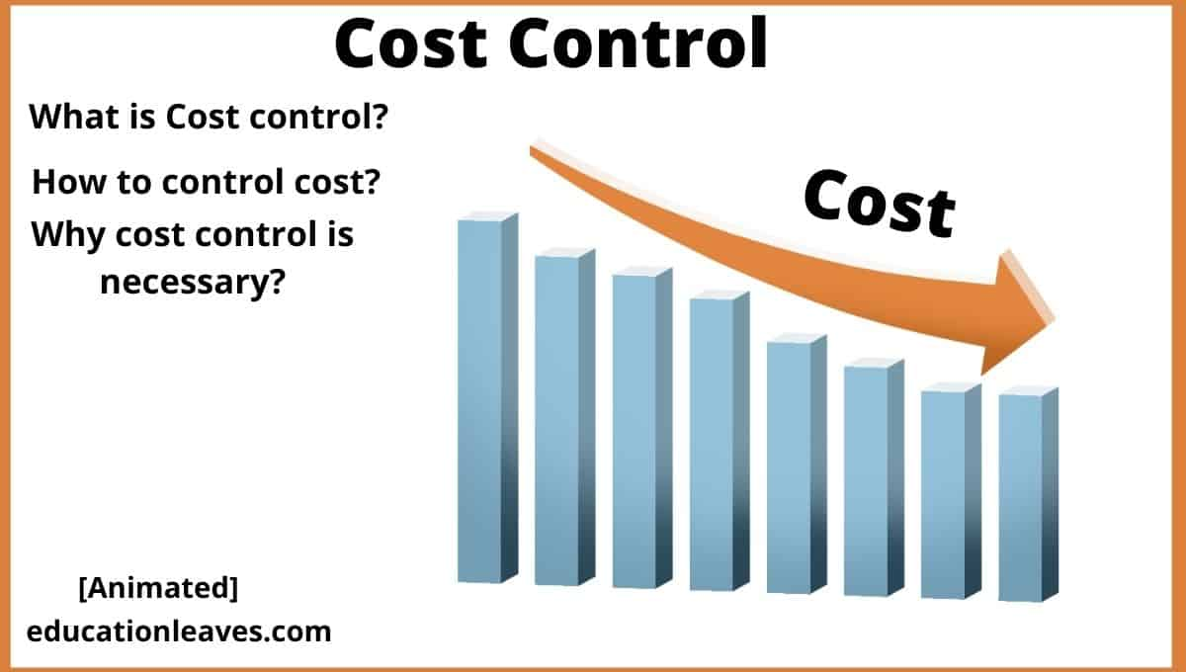
OBJECTIVES OF COST CONTROL
Keep costs within the approved budget.
Improve profitability.
Prevent wastage of materials, labour, and time.
Increase operational efficiency.
Support better decision-making through cost analysis.

Slide 4
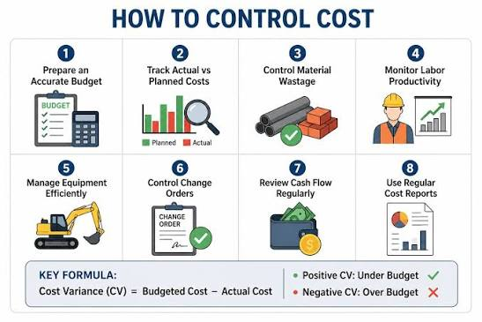
PROCESS OF COST CONTROL
Set cost standards and budgets.
Measure actual costs.
Compare actual costs with budgeted costs.
Identify and analyse cost variances.
Take corrective actions to control future costs.

Slide 5
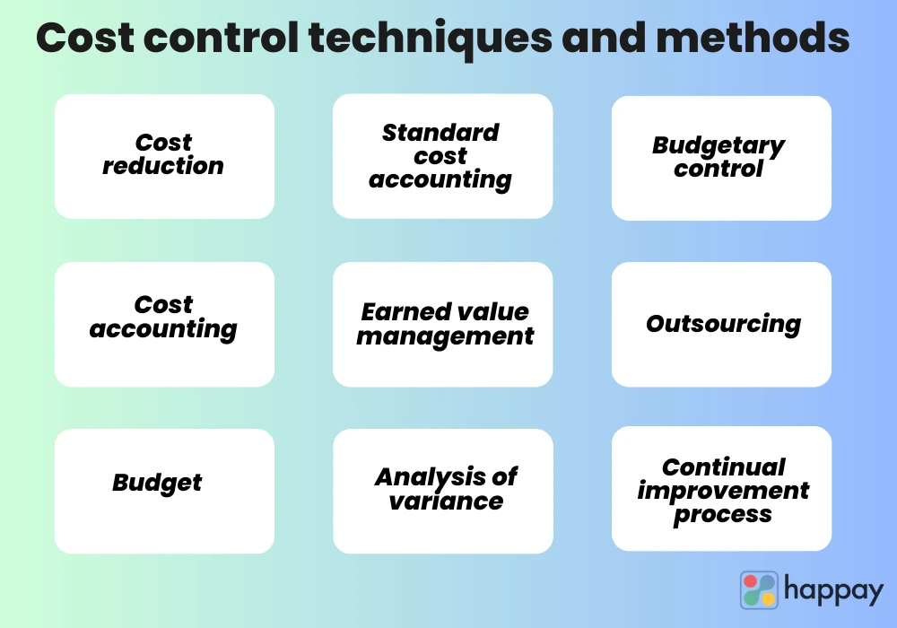
TECHNIQUES OF COST CONTROL
Budgetary Control
Standard Costing
Inventory Control
Cost Audit
Variance Analysis
Internal Financial Reporting

Slide 6
COST REDUCTION
Cost Reduction is the process of permanently reducing the cost of producing goods or providing services without compromising their quality, performance, or customer satisfaction. It focuses on eliminating unnecessary expenses, improving efficiency, and making better use of resources through improved methods, technology, and management practices.

Slide 7
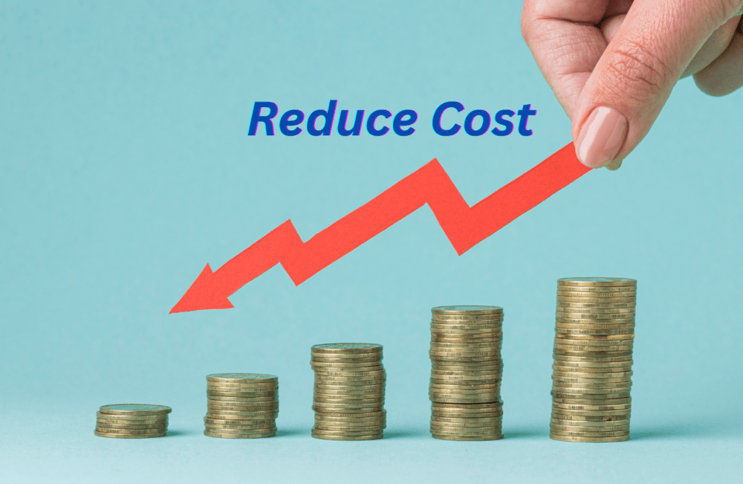
OBJECTIVES OF COST REDUCTION
Reduce production and operating costs.
Increase business profits.
Eliminate waste and inefficiencies.
Improve resource utilization.
Maintain product quality.
Enhance customer satisfaction.
Strengthen market competitiveness.

Slide 8
AREAS OF COST REDUCTION
Material Cost
Reduce material wastage.
Purchase at competitive prices.
Labour Cost
Improve employee productivity.
Provide skill training.
Overhead Cost
Save electricity and fuel.
Reduce administrative expenses.
Production Cost
Improve production methods.
Use modern technology.

Slide 9
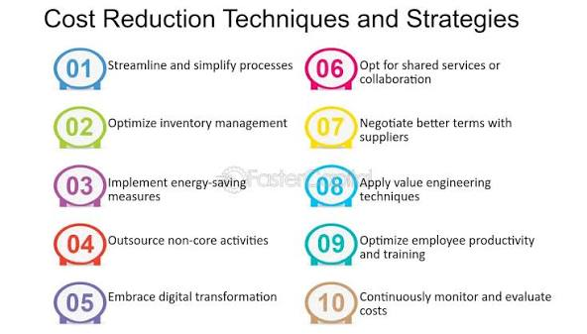
TECHNIQUES OF COST REDUCTIONS
Value Analysis
Value Engineering
Standardization
Simplification
Automation
Better Inventory Management
Process Improvement
Waste Reduction

Slide 10
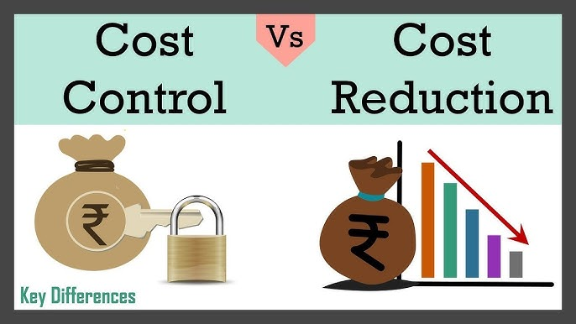
DIFFERENCE BETWEEN
COST CONTROL AND COST REDUCTION
Cost Control | Cost Reduction
It is the process of keeping costs within predetermined limits or standards. | It is the process of permanently reducing the cost per unit without affecting quality or performance.
Focuses on preventing unnecessary increases in costs. | Focuses on achieving real savings through improved methods and efficiency.
It is a continuous monitoring process. | It is a corrective and improvement-oriented process.
Standards and budgets are used to compare actual costs. | New techniques, innovation, and process improvements are used to lower costs.
Example: Monitoring material usage to ensure it stays within the budget. | Example: Replacing an expensive raw material with a cheaper alternative of the same quality.

Slide 11
CONCLUSION
Cost control and cost reduction are important tools for managing business expenses effectively. Cost control helps keep costs within the planned budget through regular monitoring, while cost reduction focuses on permanently lowering costs without compromising the quality of products or services. Together, they improve efficiency, reduce waste, increase profitability, and ensure better use of resources. By adopting these practices, businesses can strengthen their financial position, remain competitive, and achieve sustainable long-term growth.

